Slide 1
Diffusion model

Slide 2
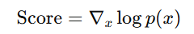
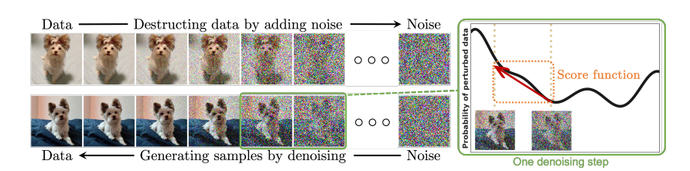
FOUNDATIONS OF DIFFUSION MODELS
Diffusion models are probabilistic generative models that learn data distributions by destroying data with noise and then reconstructing it.
The forward process incrementally transforms complex data into a simple Gaussian prior.
The reverse process learns how to undo noise using deep neural networks.
These models generate high-quality samples in images, audio, text, 3D, etc.
Three major formulations:
DDPM (Denoising Diffusion Probabilistic Models)
SGM (Score-Based Generative Models)
Score SDE (Continuous-time diffusion models)
Formula :-

Slide 3
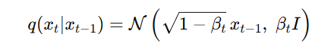
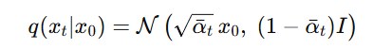
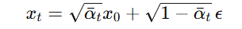
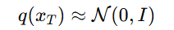
DENOISING DIFFUSION PROBABILISTIC MODELS (DDPMS)
DDPM forward process is a Markov chain that gradually corrupts data.
Each step adds a small amount of Gaussian noise.
Designed so that after many steps, data becomes nearly pure Gaussian noise.
Forward transition kernel:
Hyperparameter schedule {βₜ} controls noise rate.
Closed-form expression after t steps:
Sampling from forward process:
When 𝑡 = 𝑇 t=T, distribution approximates:

Slide 4
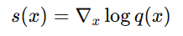
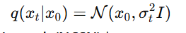
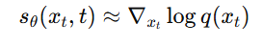
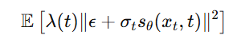
Score-Based Generative Models (SGMs)
SGMs use score functions:
Idea: Add noise at multiple scales, then train a network to estimate the score field.
Noise perturbation:
A Noise-Conditional Score Network (NCSN) learns:
Training: Denoising Score Matching

Slide 5
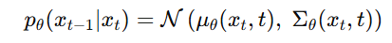
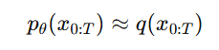
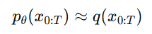
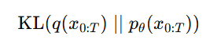
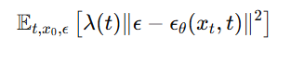
DDPM Reverse Process + Training Objective
Reverse process is also a Markov chain, but learned:
Sampling steps: Start from noise 𝑥 𝑇 ∼ 𝑁 ( 0 , 𝐼 ) x T ​ ∼N(0,I), then iteratively denoise.
Training Objective
Train θ so that:
Equivalent to minimizing:
Simplified Practical Loss (Ho et al., 2020)
Predict noise instead of mean:

Slide 6
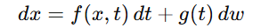
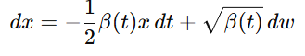
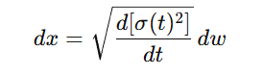
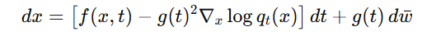
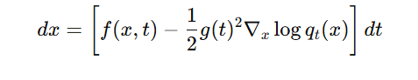
Score SDEs: Continuous-Time Diffusion
Score SDEs generalize DDPMs/SGMs to continuous time.
Forward diffusion SDE:
DDPM forward SDE:
SGM forward SDE:
Reverse-Time SDE
Converts noise → data:
Probability Flow ODE
Deterministic version (no noise):

Slide 7
ADVANCED TECHNIQUES FOR IMPROVED LIKELIHOOD
Noise Schedule Optimization - Cosine schedules, VDMs, and signal-to- noise ratio approaches
Reverse Variance Learning - iDDPM parameterization and Analytic- DPM optimal formulas
Exact Likelihood Computation - SDE vs ODE approaches, Score Flows
Special Data Structures - Discrete data and invariant structures (graphs, molecules)
Manifold Structures - Riemannian geometry and latent space diffusion

Slide 8
Noise Schedule Optimization
Traditional diffusion models use handcrafted, non-trainable noise schedules
iDDPM: Introduces cosine noise schedule that significantly improves log-likelihoods
VDM (Variational Diffusion Models): Jointly trains noise schedule using monotonic neural network γ_η(t)
Key insight: VLB depends only on signal-to-noise ratio R(t) = ᾱ²_t / σ²_t
Noise schedules with identical R_min and R_max values produce the same VLB

Slide 9
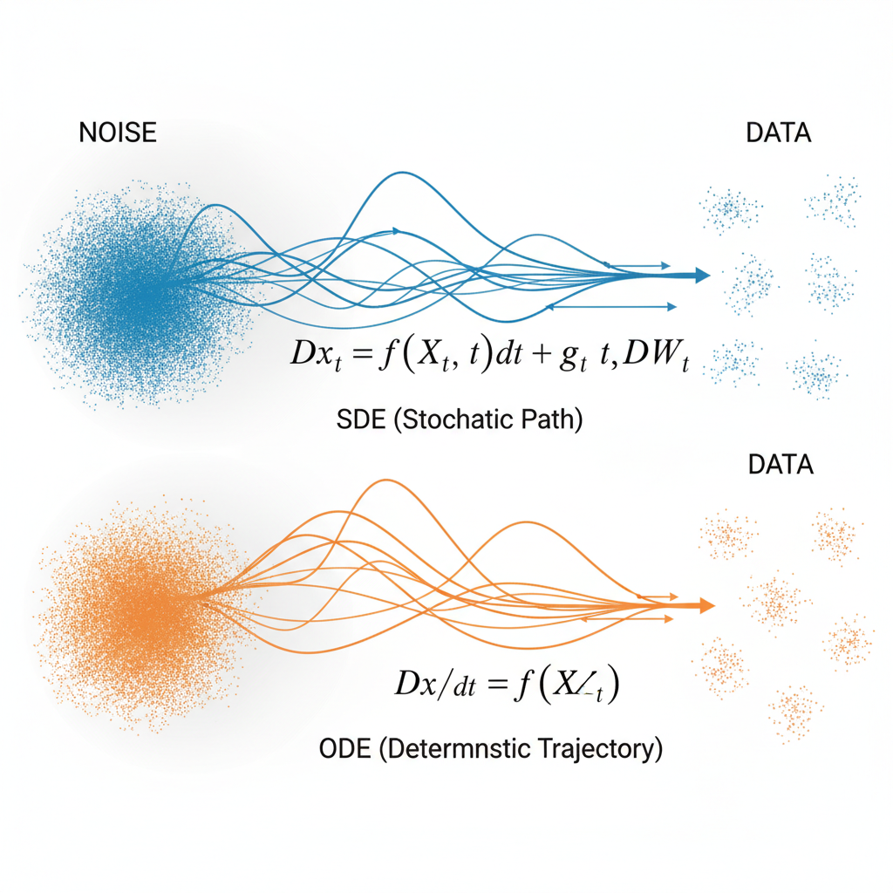
Exact Likelihood Computation - SDE vs ODE
Reverse SDE: Stochastic sampling with efficiently computable variational lower bound
Probability Flow ODE: Deterministic path enabling exact likelihood via neural ODE theory
Likelihood weighting: Training with λ(t) = g(t)² implicitly maximizes log-likelihood
KL divergence bound: D_KL(q_0 || p^sde_θ) ≤ L(θ; g(·)²) + constant
ODE computation uses Skilling-Hutchinson trace estimator

Slide 10
Reverse Variance Learning
Classical models fix reverse variance Σ_θ(x_t,t) to β_t·I
iDDPM Parameterization: Linear interpolation in log-space between β_t and β̃_t
Analytic-DPM: Derives optimal variance analytically from pre-trained score function
Benefits: Higher log-likelihoods, faster sampling, improved numerical stability
Hybrid training objectives maximize VLB without sacrificing sample quality

Slide 11
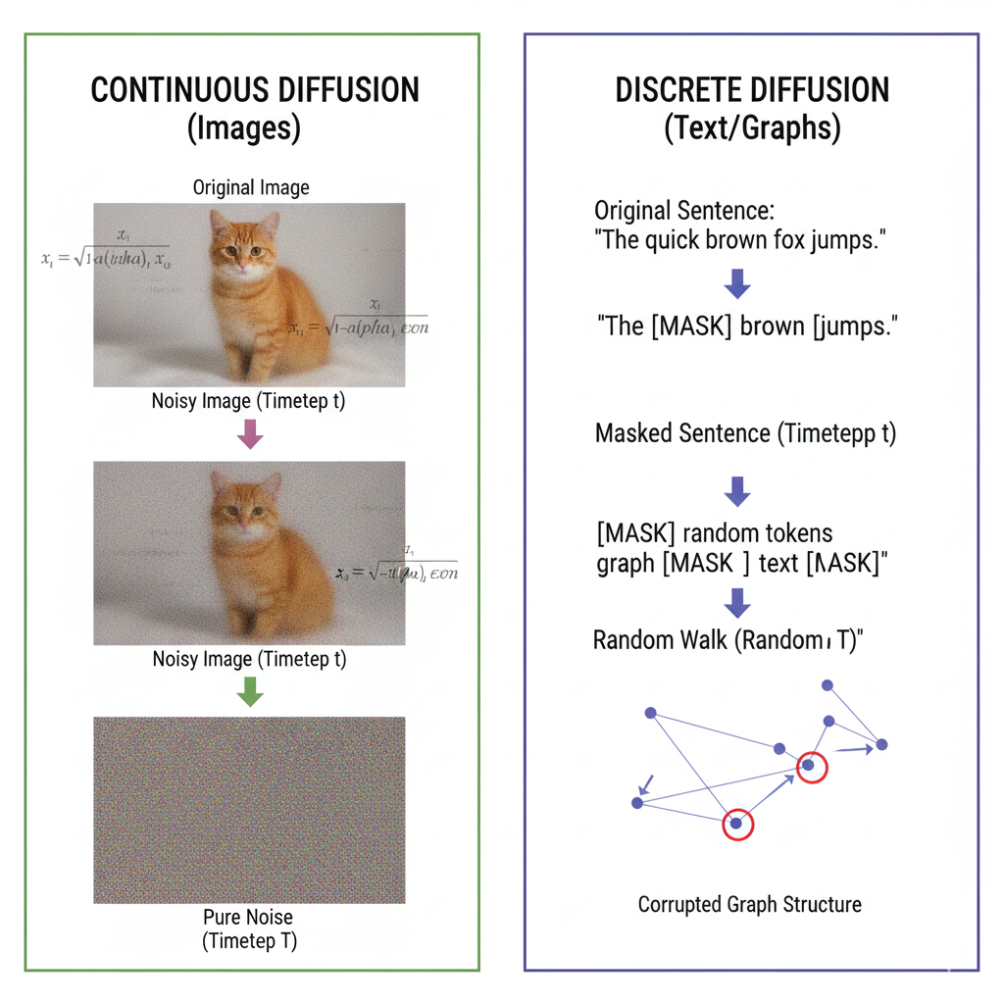
Discrete Data Diffusion
Standard Gaussian noise doesn't apply to discrete data (text, graphs, molecules)
VQ-Diffusion: Replaces Gaussian noise with random walk or random masking operations
D3PM: Uses absorbing state kernels and discretized Gaussian kernels
Concrete Score Matching: Finite-difference approximation for discrete score functions
Applications: Language modeling, discrete sequences, categorical data

Slide 12
Score Flows & Higher-Order Matching
Score Flows: Maximize VLB of p^sde_θ as a proxy for p^ode_θ
Reduces computational cost of direct ODE likelihood optimization
Higher-Order Score Matching: Minimizes 1st, 2nd, and 3rd order errors
Provides tighter bounds on log p^ode_θ through generalized loss functions
Efficient training algorithms achieve improved likelihood on real data

Slide 13
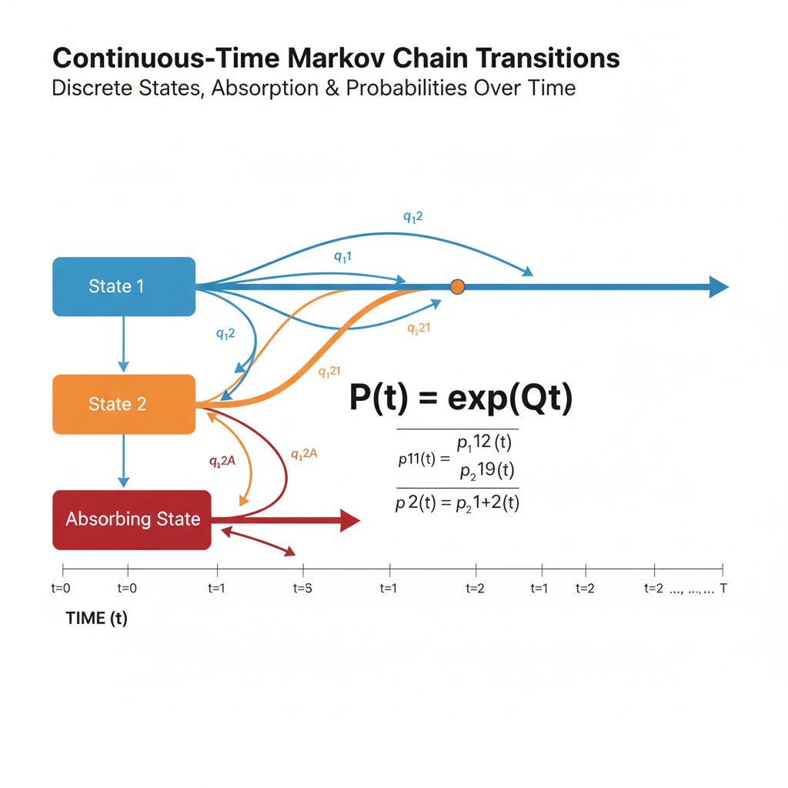
Discrete Diffusion - Advanced Methods
Continuous-Time Markov Chains: More efficient samplers than discrete counterparts
MMaDA: Multi-modal discrete generation using masked autoencoder architecture
TraceRL: Extends to reinforcement learning with reward signals and policy constraints
Doob's h-transform: Constrains distribution using special force terms in reverse process
Theoretical analysis: Bounds error between sample and true data distributions

Slide 14
Data with Invariant Structures
Many domains have natural symmetries: graphs (permutation), molecules (rotation/translation)
EDP-GNN & GDSS: Use equivariant graph neural networks for permutation-invariant generation
Molecular Diffusion: Equivariant Markov kernels ensure rotation/translation invariance
Mathematical guarantee: If prior and kernels are invariant, samples inherit invariance
Applications: Graph generation, molecular conformations, point cloud synthesis

Slide 15
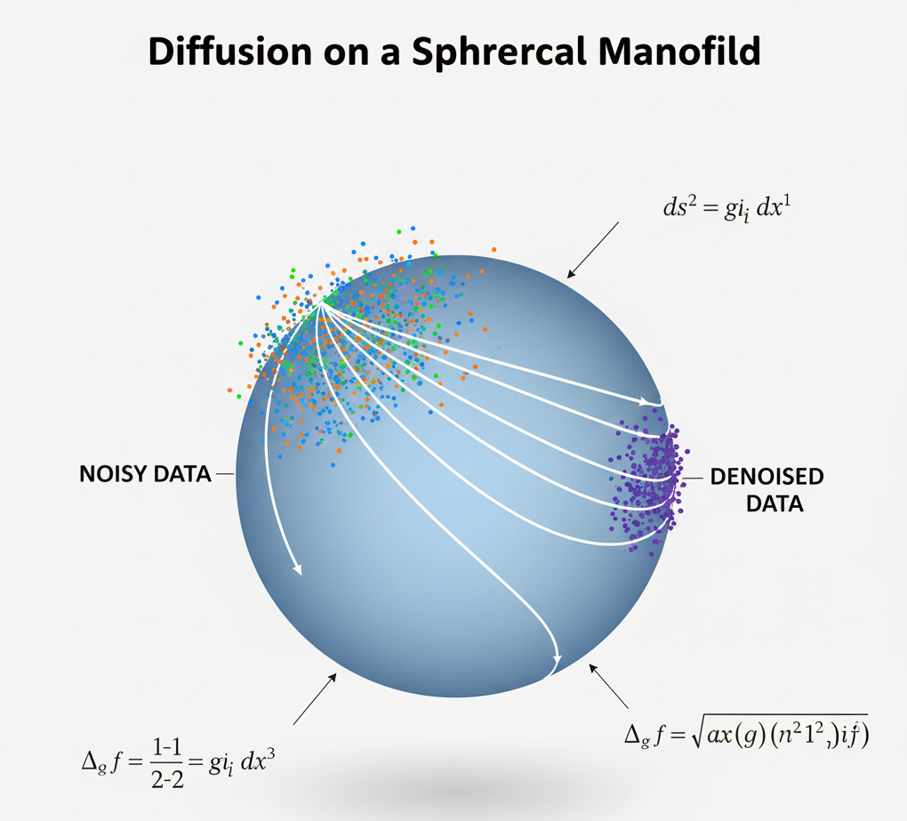
Riemannian Manifolds - Known Geometries
Extends Score SDE formulation to spheres, tori, and compact Riemannian manifolds
RSGM (Intrinsic View): Uses Geodesic Random Walk, generalized denoising score matching
RDM (Extrinsic View): Manifold embedded in Euclidean space, VLB framework
Applications: Climate data (spherical earth), molecular torsion angles, directional data
Adapted score matching and score functions for Riemannian geometry

Slide 16
Learned Manifolds - Latent Space Diffusion
LSGM: Pairs Score SDE with VAE for joint training, unified log-likelihood bound
LDM (Latent Diffusion): Sequential training - autoencoder first, then diffusion in latent space
DALL-E 2: Operates on CLIP image embeddings for semantic generation
SADMs: Adversarial discriminator preserves manifold structure within batches
Key advantage: Dramatically reduces computational cost while maintaining quality

Slide 17
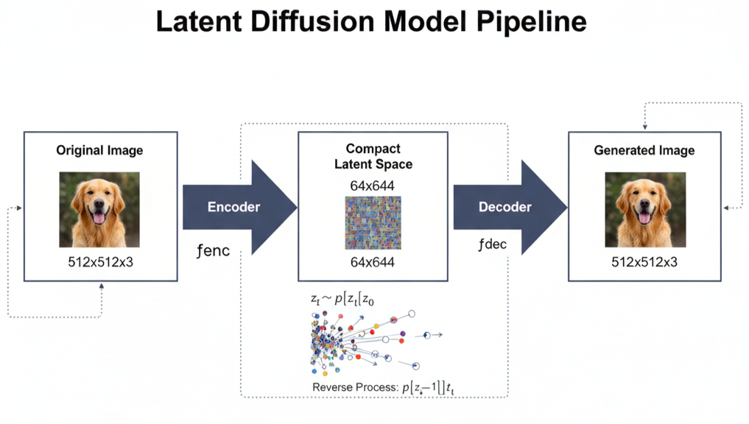
Latent Diffusion Architecture
Manifold hypothesis: Natural data lies on lower-dimensional manifolds
Autoencoder compresses data → Diffusion operates in latent space → Decoder reconstructs
Dramatic computational savings by working in compressed representation
Enables high-resolution generation (images, videos) that was previously intractable
Successfully used in Stable Diffusion, DALL-E 2, and modern text-to-image systems

Slide 18
CONNECTIONS WITH OTHER GENERATIVE MODELS
Large Language Models (LLMs) enhance diffusion models by adding reasoning, planning, and semantic understanding to visual and multimodal generation. LLMs act as high-level planners, while diffusion models handle detailed image or video creation—resulting in more coherent, controllable, and high-quality outputs.
Large Language Models and Connections with Diffusion Models
LLMs improve text-image alignment and compositional control.
Used in tools like RealCompo, EditWorld, VideoTetris, MMaDA, TraceRL, and RPG.
Enable cross-modal, temporal, and reinforcement learning-based generation.
Together, they form intelligent, semantically rich generative systems.

Slide 19
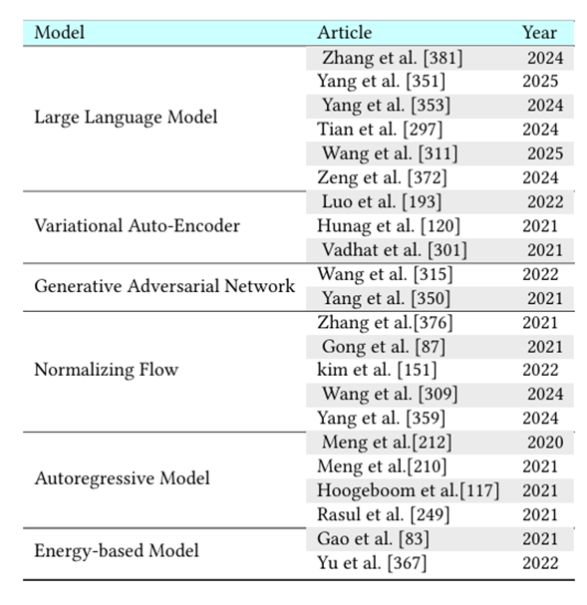
Table 1. Diffusion models are incorporated into different generative models

Slide 20
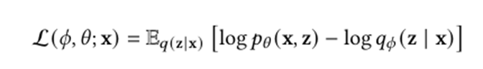
Variational Autoencoders and Connections with Diffusion Models
Variational Autoencoders (VAEs) learn to encode data into a latent space and decode it back using probabilistic models optimized by the ELBO. Diffusion models can be viewed as hierarchical or infinitely deep VAEs, where the forward process acts as the encoder and the reverse process as the decoder. This links diffusion training with variational inference, showing both share a common probabilistic foundation
.
VAEs optimize ELBO for probabilistic data reconstruction.
Diffusion models function as hierarchical VAEs (encoder = forward process, decoder = reverse process).
Continuous-time diffusion ≈ infinitely deep VAE.

Slide 21
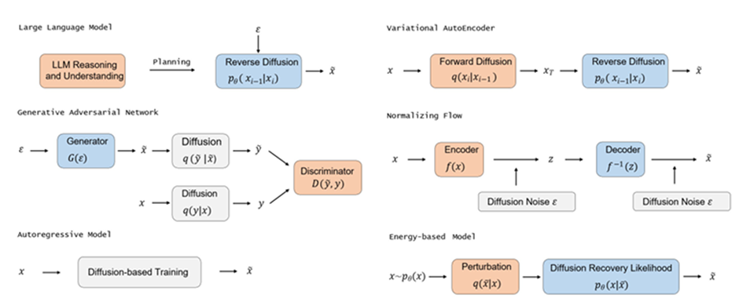

Slide 22
Generative Adversarial Networks and Connections with Diffusion Models
GANs use a generator and discriminator in a mini-max game to learn data distributions but often face training instability. Integrating diffusion models helps stabilize GAN training and enhance realism, while GANs can speed up diffusion sampling.
GAN = Generator + Discriminator trained via mini-max optimization.
Training instability arises from non-overlapping distributions.
Diffusion adds adaptive noise to stabilize GANs (Wang et al., 2022).
Conditional GANs accelerate diffusion sampling (Xiao et al., 2021).

Slide 23
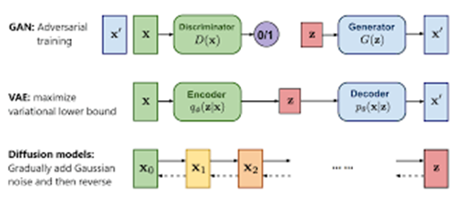

Slide 24
Normalizing Flows and Connections with Diffusion Models
Normalizing flows transform simple probability distributions into complex ones through invertible mappings, enabling exact likelihood estimation.
Diffusion–flow hybrids combine the stability of diffusion with the efficiency of flow models, producing sharper and faster results.
Latent diffusion approaches use normalizing flows for encoding before applying diffusion, improving likelihood and sampling speed.
Consistency flow methods enforce velocity consistency, bridging flow matching and diffusion models for smoother training.

Slide 25
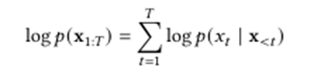
Autoregressive Models and Connections with Diffusion Models
Autoregressive Models (ARMs) generate data sequentially but are slow for high-dimensional tasks. Integrating diffusion techniques improves efficiency and sample quality
ARMs model data as sequential conditional probabilities.
Autoregressive Diffusion Models (ARDM) enable faster, parallel generation.
Randomized smoothing enhances sample quality.
AR-CSM uses score matching for flexible and efficient modeling.

Slide 26
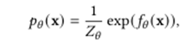
Energy-based Models and Connections with Diffusion Models
Energy-Based Models (EBMs) model data using an energy function but face challenges with costly and unstable MCMC sampling. Diffusion models address this by using diffusion recovery likelihood, which makes training more efficient and stable.
EBMs assign low energy to real data, high to fake data.
Training via MCMC is slow and unstable.
Diffusion recovery likelihood enables easier, stable learning.
Integration improves efficiency and sample quality.

Slide 27
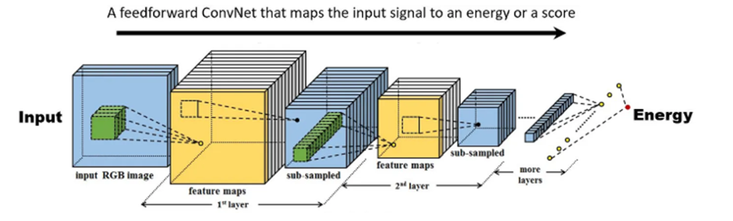

Slide 28
Improving the Core Model
Weaknesses:
Slow sampling: requires up to T=1000 denoising steps.
Poor likelihood estimation: not as tight as normalizing flows.
Redundant computations: many noise steps are near-identity transformations.
Improvement 1: Efficient Sampling (Faster Generation)
Goal: Original DDPM needs 1000 denoising steps to generate one image. So, reduce sampling steps from T = 1000 → ~10–50 while keeping image quality high.
1. DDIM(Denoising Diffusion Implicit Models) : Learning free and Faster.
Skipping frames — every 20th frame rather than 1000 one by one. It focuses entirely on speeding up the generation process, not on training or model design.

Slide 29
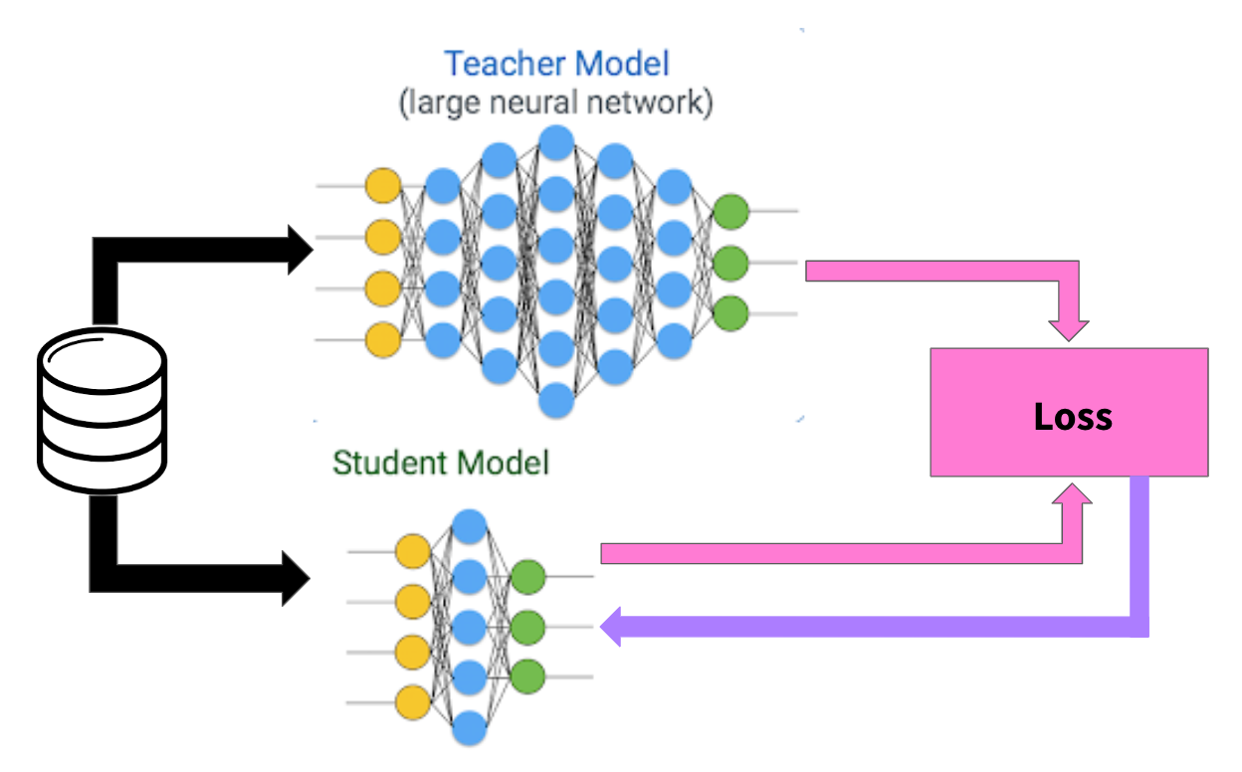
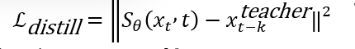
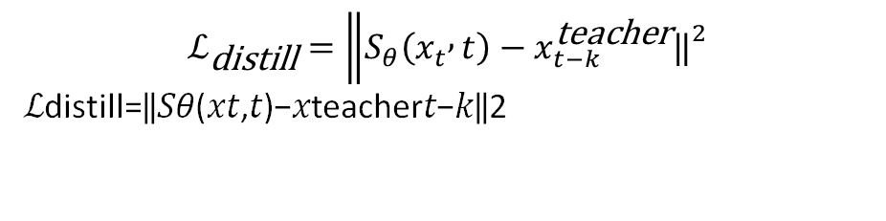
2. Model Distillation (Learning Based):
Train a new model.
Distillation replaces this long chain of DDPM with a new neural network that learns to simulate m steps at once.
$$ℒ_{\text{distill}}=\left\|S_{θ}\left(x_{t} , t\right)−x_{t−k}^{\text{teacher}}{\left.‖\right.}^{2}\right.$$
ℒdistill=‖𝑆𝜃(𝑥𝑡,𝑡)−𝑥teacher𝑡−𝑘‖2

Slide 30
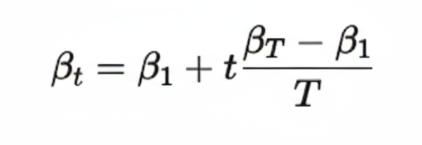
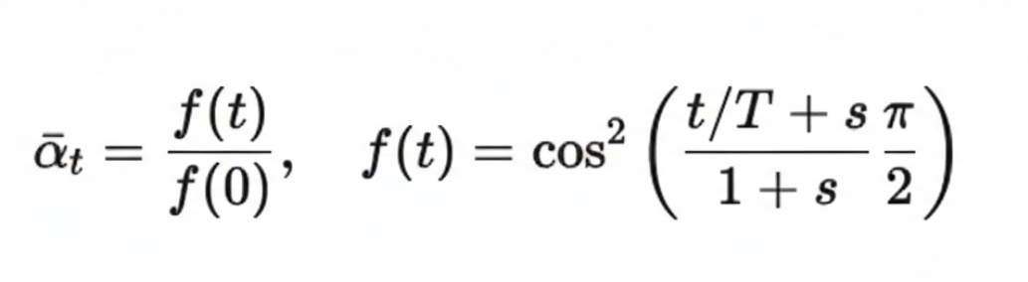
Improvement 2: improved likelihood:
Noise Schedule Optimization
- The original DDPM used:
Linear Schedule(β_{t}): Where β: controls the noise added at each timestep.
Cosine Schedule: Nichol & Dhariwal (2021) introduced iDDPM.

Slide 31
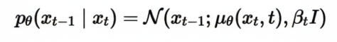
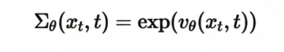
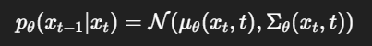
2. Variance modelling
Original (DDPM):
Learned :(with stability Clipping)
3. Likelihood Estimation
Improved DDPM trains the model to predict both:
the mean (or noise ε)
the variance Σₜ
But to avoid instability, they “clip” Σₜ to a safe range.

Slide 32
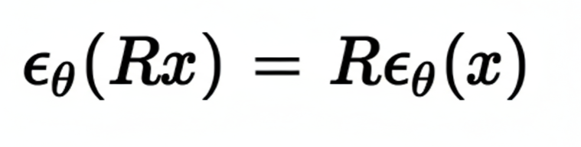
Improvement 3: Handling special data
Discrete Data (Text, Categorical Variables)
Solution(D3PM)—Discrete Denoising Diffusion Probabilistic Models
Instead of Gaussian noise, D3PM adds discrete corruption: random token flipping, Masking, categorical diffusion transitions Forward process becomes a Markov chain over discrete symbols:
q( x_{t}∣ x_{t−1})=Q_{t} [ x_{t−1} , x _{t} ]
2. Data with Invariant Structure (Graphs, Molecules)
Solution: These require rotation and translation equivariance:
rotate input ⇒ output also rotates
Equivariant GNNs (e.g., EGNN, SE(3)-Transformer):diffusion steps preserve geometric structure

Slide 33
Application of Diffusion model Computer Vision
• Super-resolution
• Inpainting & restoration
• Translation & editing
• Semantic segmentation
• Video generation
• Synthetic data generation
• Point cloud generation
• Anomaly detection

Slide 34
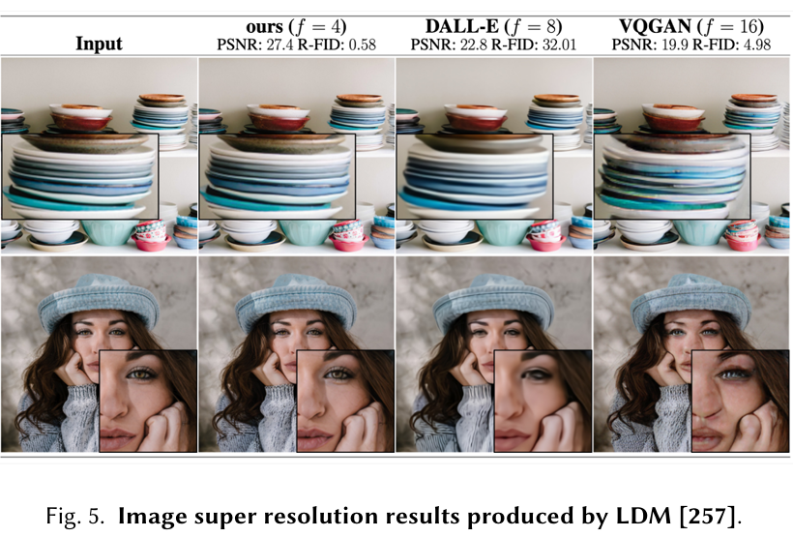
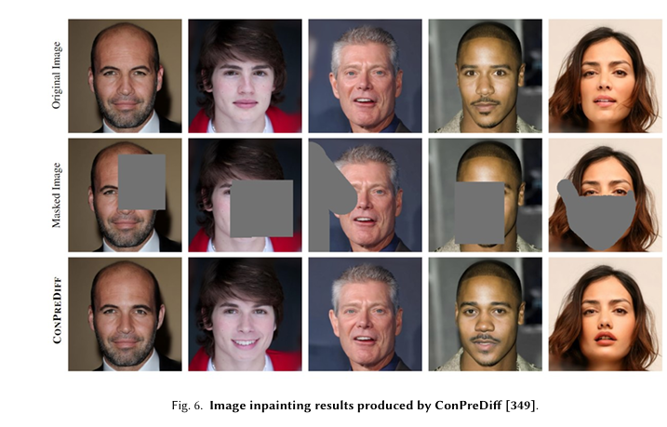
Super-Resolution & Restoration
• Enhances low-quality images
• Restores missing/occluded regions

Slide 35
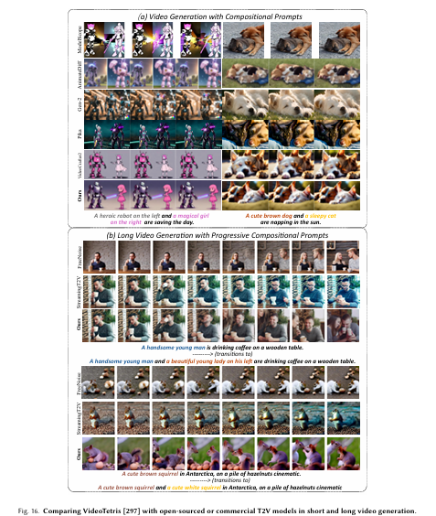
Video & 3D Generation
• Text-to-video models
• Frame interpolation
• Point cloud completion
• 3D object/scene modeling

Slide 36
Natural Language Generation
• Discrete diffusion (D3PM)
Diffuses over token space; recovers discrete text step-by-step for
fluent sentence generation.
• Diffusion-LM for controlled text
Controls text attributes (style, sentiment, length) by diffusing word
sembeddingss.
• DiffuSeq for seq-to-seq tasks
Seq-to-seq diffusion for tasks like translation, summarization, and
rewriting.

Slide 37
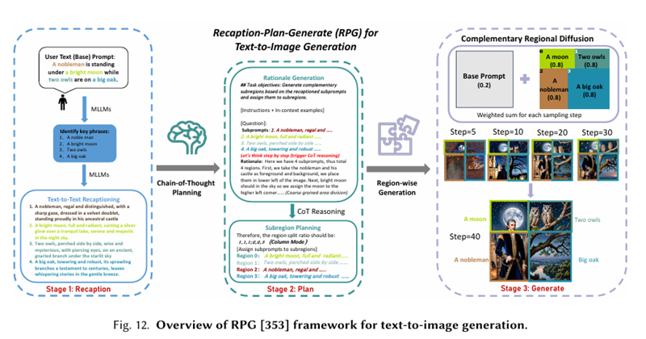
Multi‑Modal Generation
• Text-to-image
• Scene graph to image
• Text-to-3D/4D
• Text-to-motion
• Text-to-video
• Text-to-audio

Slide 38
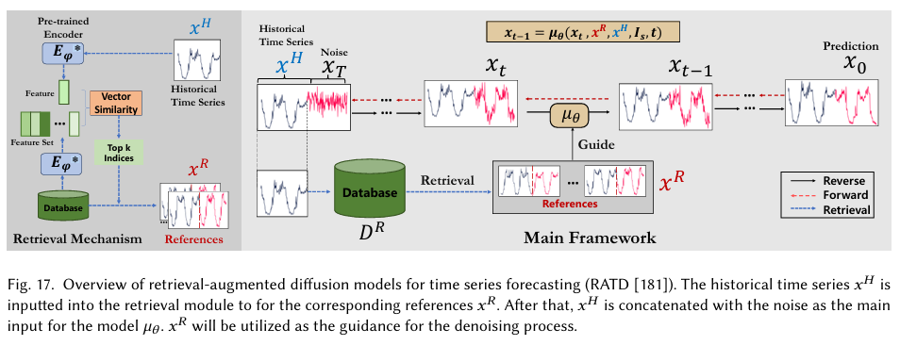
Temporal Data Modeling
• Time series imputation
• Time series forecasting
• Waveform/audio signal generation

Slide 39
Robust Learning
• Defense against adversarial attacks
Diffusion models remove adversarial noise through denoising.
• DiffPure purification
Adds noise → reverses diffusion → purifies the attacked input.
• Randomized purification
Uses random noise injection to break adversarial patterns.
• Guided diffusion for robustness
Guided denoising generates stable, attack-resistant outputs.

Slide 40
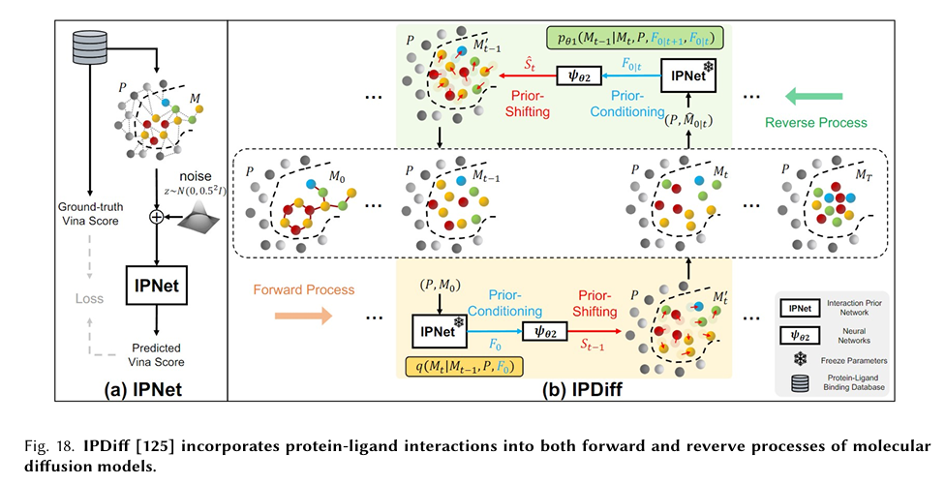
Interdisciplinary Applications
• Drug design (IPDiff, BindDM, IRDiff)
• Molecule/protein generation
• Material design
• Medical image reconstruction

Slide 41
Summary
• Diffusion models are used across vision, language, multi-modal tasks, time-series, security, and sciences.
• They outperform GANs in stability and quality.
• Their controllability makes them suitable for real-world tasks.

Slide 42
CONCLUSION
Gave a broad overview of diffusion models and explained the three main formulations: DDPMs, SGMs, and Score SDEs.
Reviewed recent advancements focusing on sampling efficiency, likelihood improvement, and handling structured or complex data.
Discussed how diffusion models relate to other generative models and the advantages of integrating them.
Summarized applications across several domains, showing their wide practical use.

Slide 43


IMAGES
A fantasy dragon flying above a medieval castle, dramatic lighting, high detail.
A sci-fi robot exploring an alien planet with purple skies and glowing plants.

Slide 44
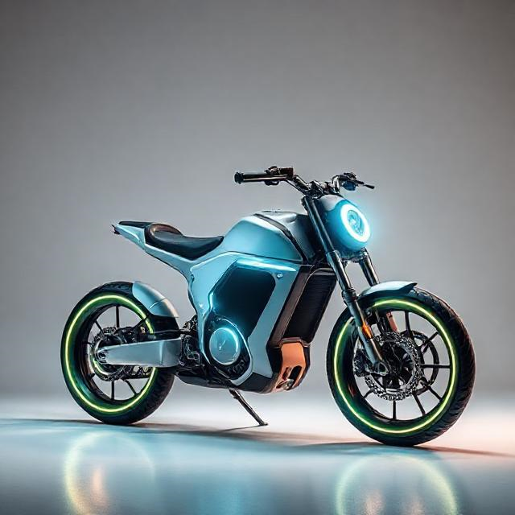
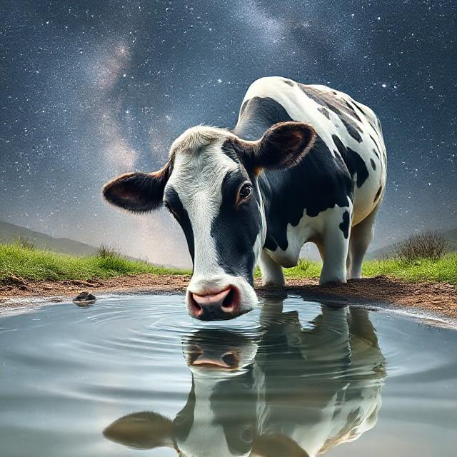
A cow drinking water in a milky way.
A futuristic electric bike concept in studio lighting

Slide 45
References
Deep Unsupervised Learning using Nonequilibrium Thermodynamics - https://arxiv.org/abs/1503.03585
Denoising Diffusion Probabilistic Models - https://arxiv.org/abs/2006.11239
Diffusion Models: A Comprehensive Survey of Methods and Applications - https://arxiv.org/abs/2209.00796
Diffusion Models in Vision: A Survey - https://arxiv.org/abs/2209.04747

Slide 46
contributors
Harshal Dharpure | 2511AI30 | 4.7%
Manish Singh | 2511AI52 | 4.7%
Omkar Kadam | 2511AI49 | 4.7%
Kumar Aryan | 2511AI01 | 4.7%
Siddhartha Srivastava | 2511AI34 | 4.7%
Anup Kumar | 2511CS01 | 4.7%
Mukesh Gupta | 2511CS10 | 4.7%
Prabhat Kumar Raj | 2511AI56 | 4.7%
Narender Kashyap | 2511AI45 | 4.7%
Sanidhya Tiwari | 2511AI31 | 4.7%
Satyarth Singh | 2511CS22 | 4.7%
Manu Bhaskar | 2511AI13 | 4.7%
Tirth Patel | 2511AI07 | 4.7%
Yogendra Bharadwaj | 2511AI38 | 4.7%
Vivekanand Pandey | 2511AI54 | 4.7%
Ramendra Bharadwaj | 2511AI39 | 4.7%
Jeel Patel | 2511AI12 | 4.7%
Ved Parkash | 2511AI58 | 4.7%
Abhishek Kumar | 2511AI27 | 4.7%
Avdhoot Lendhe | 2511AI57 | 4.7%
Kushagra Raj | 2511AI50 | 4.7%

Slide 47

Thank you

